Slide 1
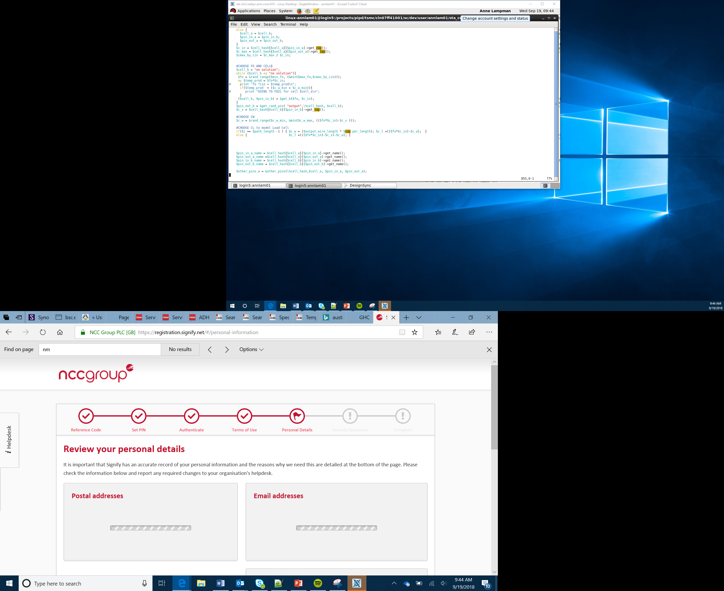

Smart Cities Project
Lessons 15–16
Extension Ideas for streetlight

Slide 2
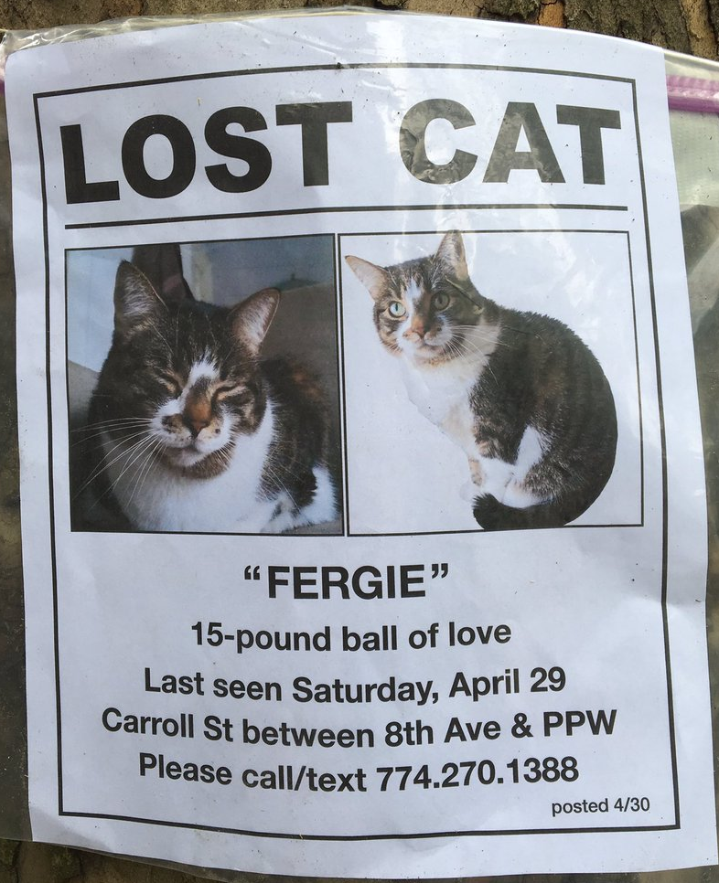
Noticeboard
The community want a noticeboard on the streetlight where they can post about lost pets, local events and community groups.
Requirements
Hints
People will create a notice at home, send it for approval and then have it displayed
Design the system using a flow chart
Connect your micro:bit to a monitor to begin creating the noticeboard

Slide 3

Dog Deterrent
Some owners allow their dogs to urinate on lamp posts. The council would like to deter them.
Requirements
Hints
The sign needs to detect moisture from the dog and then frighten it so it does not want to come back
Use the moisture sensor to detect the dog
Connect a speaker to create a noise
Find out about sounds that dogs can hear that humans cannot

Slide 4

Police Interceptors
At the scene of an accident or incident, the police would like to turn up the streetlight.
Requirements
Hints
The police officer will be able to turn up the streetlight using a phone app
Find the micro:bit app on the app store
Pair the phone to the micro:bit using Bluetooth

Slide 5
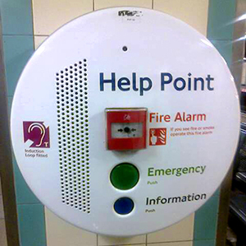
Security Light
Local people have asked for a help button so that they feel safer walking at night.
Requirements
Hints
The help button will instantly set the light to maximum and an alarm will sound
A radio signal is sent to alert the control room
Use the A and B buttons to prompt different events
Can you think of other ways streetlights could help people feel safer at night?
Transportforall.co.uk

Slide 6
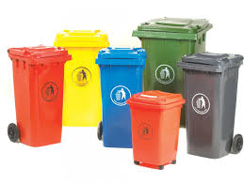
Bin Day
Local people have asked for the streetlight to remind them when to put their bins out.
Requirements
Hints
The system needs to tell them which colored bin or bins to put out
The normal bin day may change when there is a bank holiday
Find the website that has a bin calendar for your area
Create different coloured light to match the bin colors
gsindustries.co.uk

Slide 7

Freezing Conditions
Transport services need to know when the temperature has fallen below zero, so that they can grit the streets and pavements.
Requirements
Hints
The system needs to detect when the temperature has fallen below zero
The streetlight can show a warning picture
Create a warning icon for the light to show
Use a fridge to test your final system

Slide 8
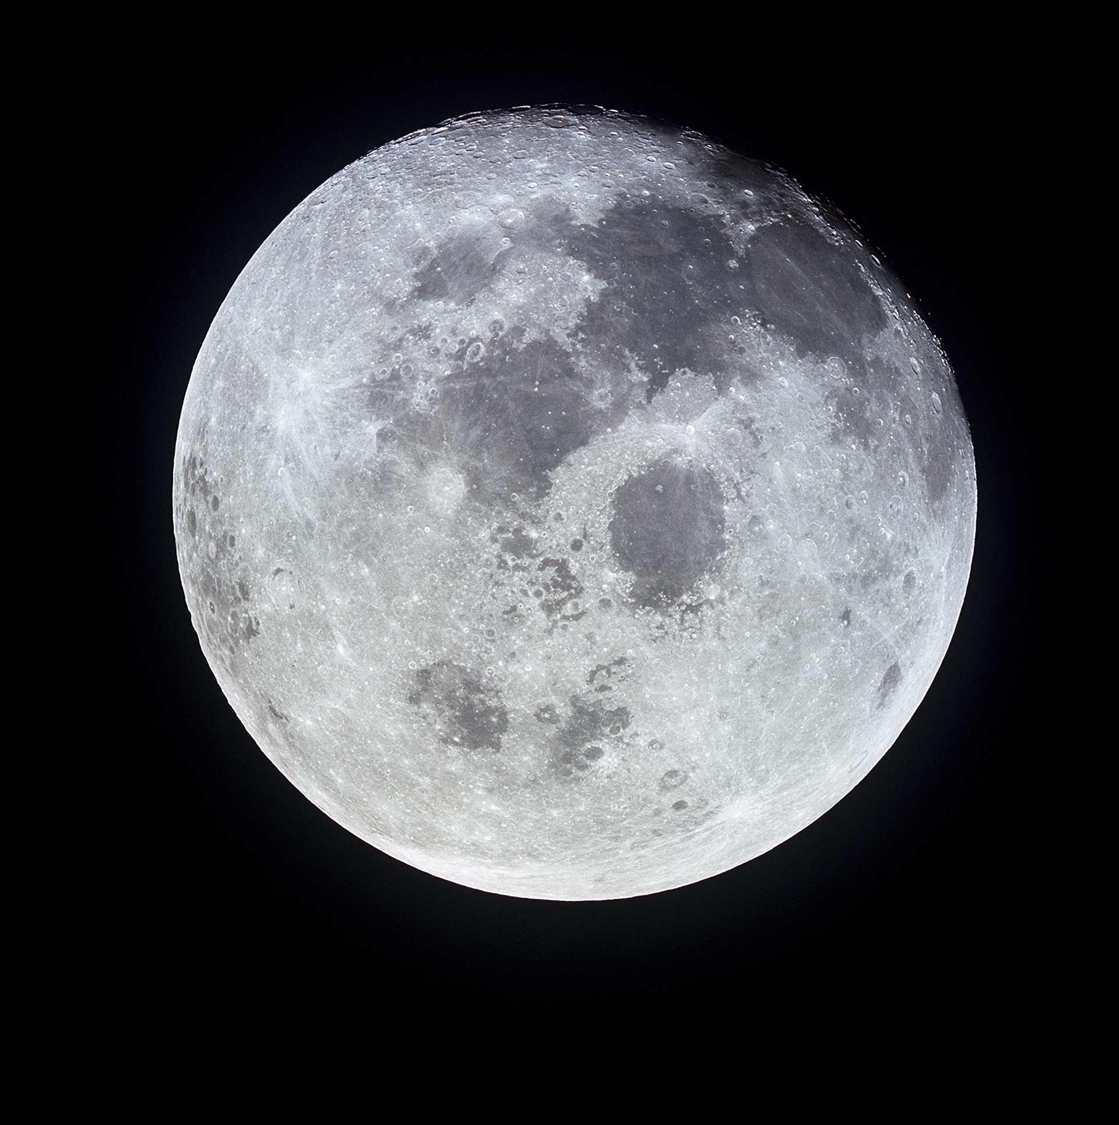
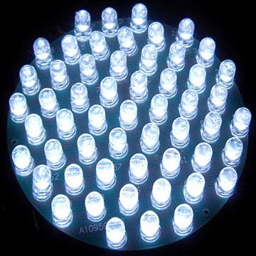
Moon Tracker
The moonlight can cast shadows. The light could move with the moon so that it is always illuminating the other side, so minimising shadows.
Requirements
Hints
The moon rises in the east and sets in the west
Learn how to use the servo with the micro:bit to create a 180^{O} turn
Use the compass sensor to set the direction
If the light is this side, it can illuminate the shadowed area
NASA

Slide 9
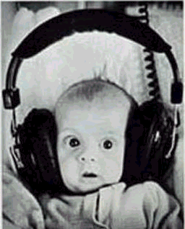
Noise Pollution
Residents in a housing estate are concerned over noise levels at night. Use the micro:bit to measure background noise levels.
Requirements
Hints
After dusk activate the built-in microphone to measure noise levels
Use the light sensor to detect when dusk is reached
Use the built-in microphone to plot a graph between 0 and 255 to measure noise levels and output them on the built in LED screen
This Photo by Unknown Author is licensed under CC BY-SA

